Slide 1
Week 6
Laboratory 06
Stellar Technical Academy

Slide 2
Lab Exercise
Create an NFT using the Stellar Laboratory
Exercise 1: Create an NFT using Laboratory
Create an NFT using the Laboratory
Session 06: Laboratory

Slide 3
NFTs and the Metaverse
Create an NFT using the Stellar Laboratory
First, you are going to head over to the Stellar Laboratory . As always, make sure you are using the testnet network (right corner and click test, if it’s not selected).
Click the tab Create Account and select the Generate Keypair button to generate the first key pair. Then fund your account with the Friendbot, as you did on Week 1.
Repeat the process to create the second keypair account.
Create two public keys for the two accounts and make sure that you don’t mix them up. The first key will be your Distributor and the second key will be your Issuer.
Session 06: Laboratory

Slide 4
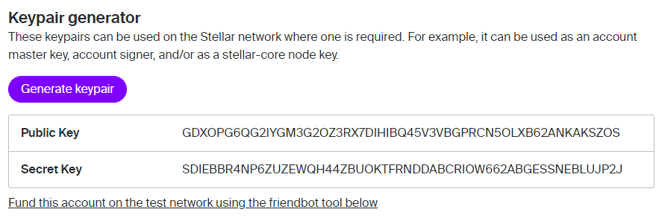

NFTs and the Metaverse
Create an NFT using the Stellar Laboratory
Generating the keypairs.
Session 06: Laboratory

Slide 5
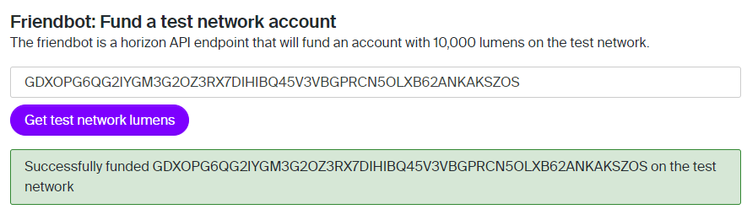
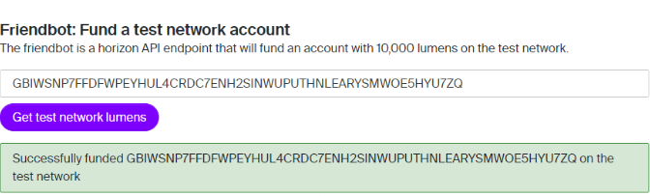
NFTs and the Metaverse
Create an NFT using the Stellar Laboratory
Now, you are going to fund the Stellar accounts using the Friendbot.
Please fund both accounts with 10,000 XLM on the test network.
Just add the public key for the account you want to fund and click on ”Get test network lumens”.
Session 06: Laboratory

Slide 6
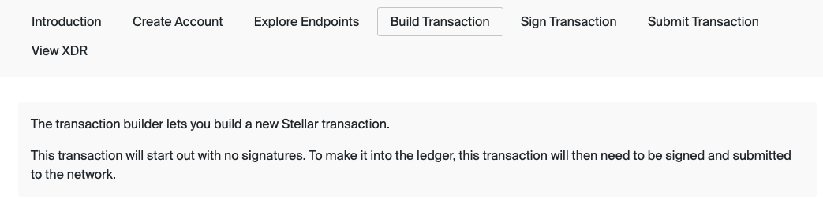
NFTs and the Metaverse
Create an NFT using the Stellar Laboratory
In the third step, set up a Trustline between the Issuer and the Distributor.
A Trustline in Stellar explicitly implies that the distribution account trusts the issuing account with the handling of the assets issued.
First, we go to the tab Build Transaction. With the transaction builder you build a new Stellar transaction on the Stellar Network.
Session 06: Laboratory

Slide 7
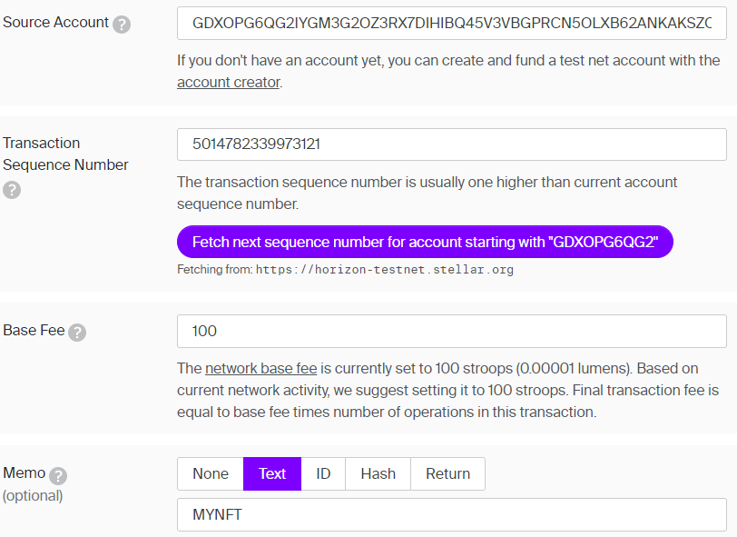
NFTs and the Metaverse
Create an NFT using the Stellar Laboratory
First, in the ‘Source Account’ field type the public key of the Distributor account.
Then, click on ‘Fetch next sequence number…’ button.
In the ‘Memo’ section, click on ‘Text’ and type ‘MYNFT’.
Session 06: Laboratory

Slide 8
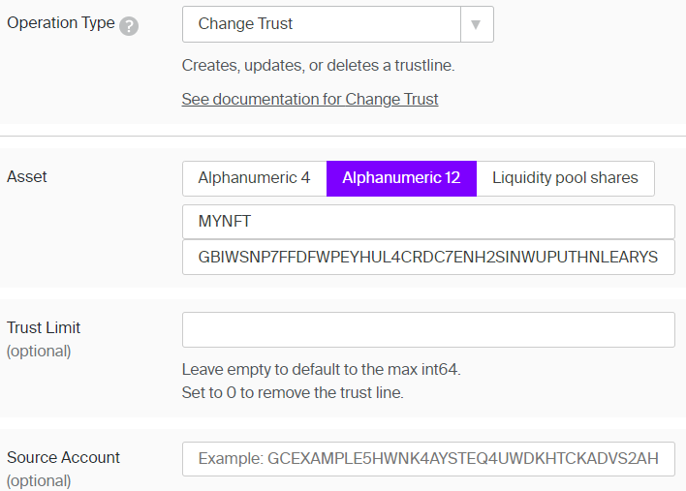
NFTs and the Metaverse
Create an NFT using the Stellar Laboratory
Now, you are going to create a Trustline between the Distributor and the Issuer).
In the ‘Operation Type’ dropdown button choose the ‘Change Trust’ option and in the ‘Asset’ field choose ‘Alphanumeric12’ and type a code (e.g., MYNFT) that is between 5 and 12 characters long.
In the ‘Issuer Account ID’ field just copy and paste the public key of the issuer account)
Session 06: Laboratory

Slide 9
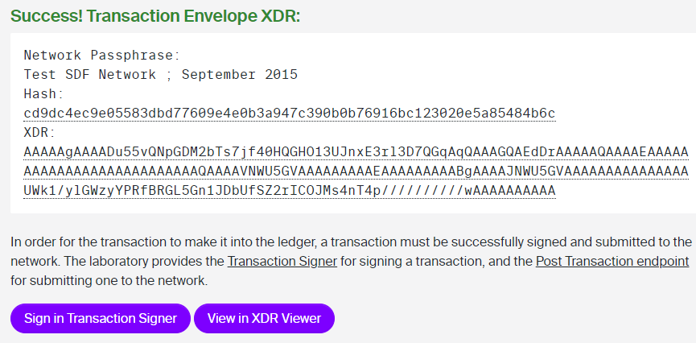
NFTs and the Metaverse
Create an NFT using the Stellar Laboratory
Then, scroll down and click on ‘Sign in Transaction Signer’.
Session 06: Laboratory

Slide 10
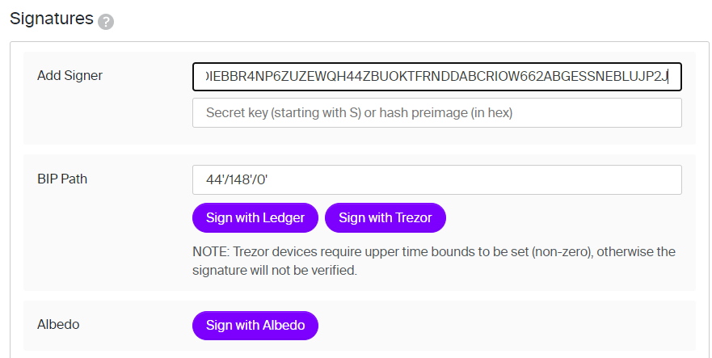
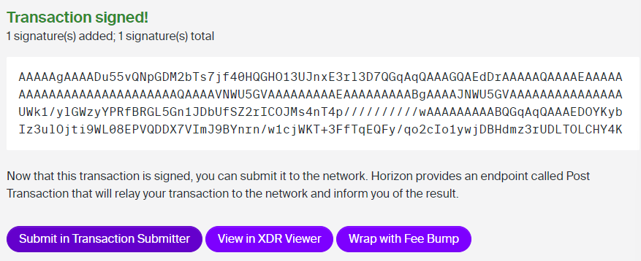
NFTs and the Metaverse
Create an NFT using the Stellar Laboratory
Then, scroll down again to the ‘Signatures’ form.
In the ‘Add Signer’ field, copy and paste the secret key of the Distributor.
Scroll down once more and click on ‘Submit in Transaction Submitter’.
Session 06: Laboratory

Slide 11
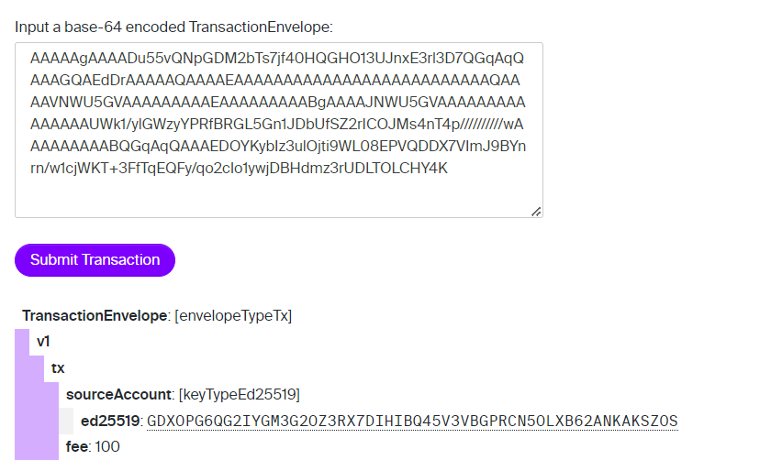
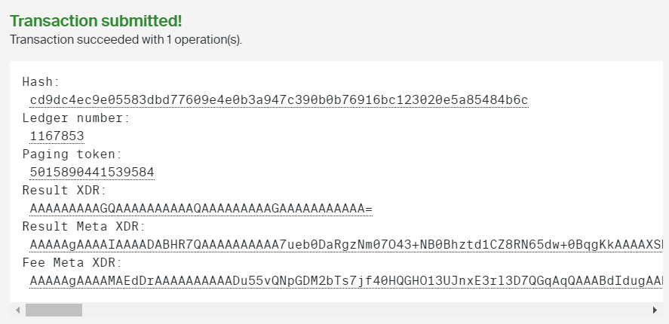
NFTs and the Metaverse
Create an NFT using the Stellar Laboratory
Click on ‘Submit Transaction’ and, if you followed all the steps correctly, then your transaction is successfully submitted and you have created the Trustline!
Session 06: Laboratory

Slide 12
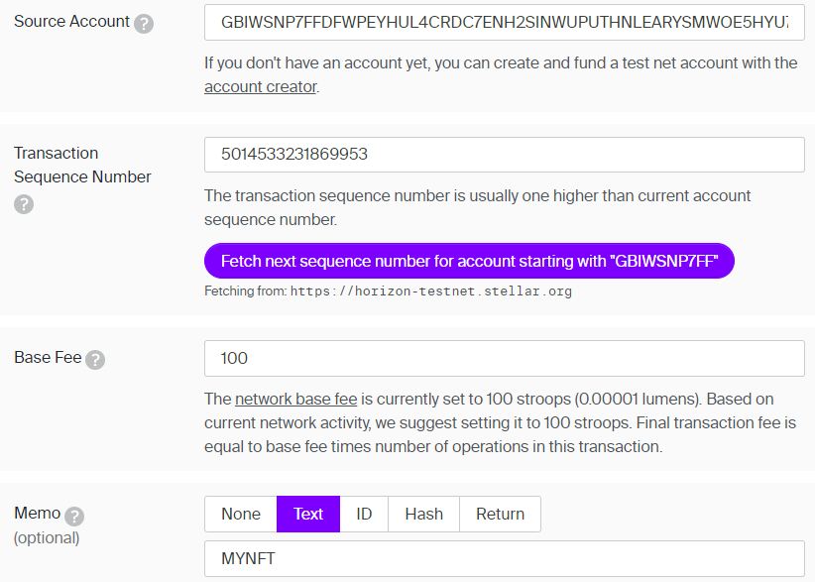
NFTs and the Metaverse
Create an NFT using the Stellar Laboratory
Now, you are going to head back to the ‘Build Transaction’ section and click on ‘Clear form contents and start over’.
Then, in the ‘Source Account’ field, you are going to copy and paste the public key of the Issuer (not the Distributor).
Then, click again on ‘Fetch next sequence number…’ and on the ‘Memo’ field choose once more ‘Text’ and write the same memo as you did before.
Session 06: Laboratory

Slide 13
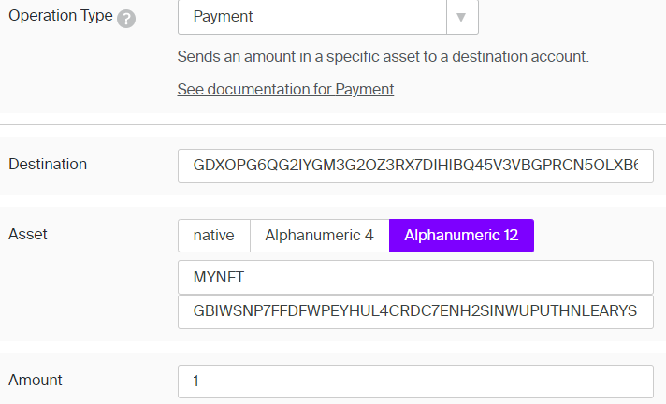
NFTs and the Metaverse
Create an NFT using the Stellar Laboratory
Up next, scroll down to the Operation Type form and choose ‘Payment’.
In the destination field type the public key of the Distributor account.
In the ‘Asset’ field follow the same steps as you did before and in the ‘Amount’ field type ‘1’.
Session 06: Laboratory

Slide 14
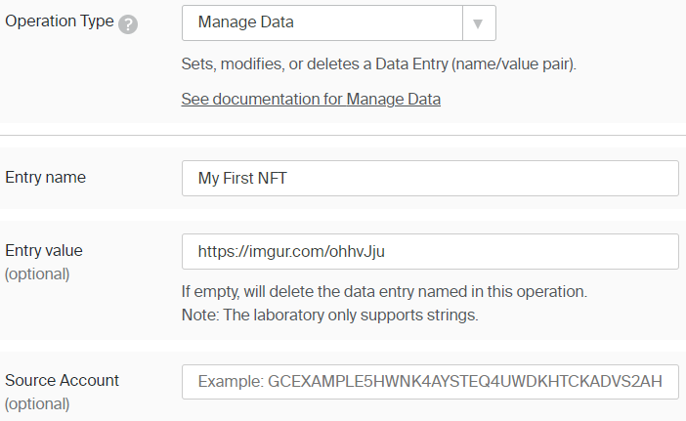
NFTs and the Metaverse
Create an NFT using the Stellar Laboratory
Now, scroll down and click on “+Add Operation”.
In the ‘Operation Type’ dropdown button choose ‘Manage Data’.
In the ‘Entry name’ field type the name you want to give to your NFT (e.g., ‘My NFT’) and in the ‘Entry value’ field type the URL of your token (e.g., the URL of a JPEG)
Once more, click on ‘+Add Operation’.
Session 06: Laboratory

Slide 15
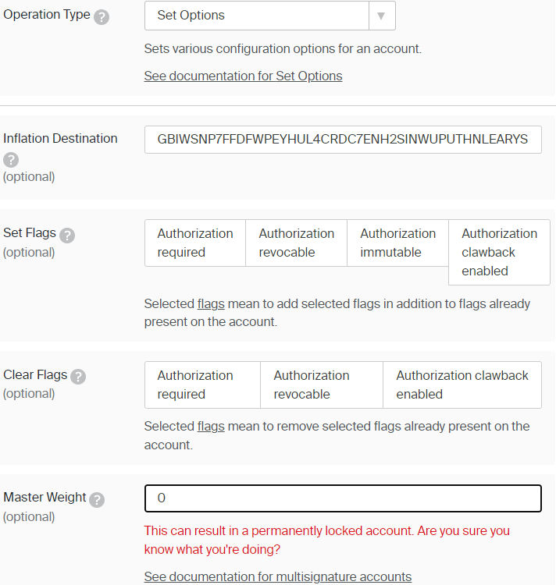
NFTs and the Metaverse
Create an NFT using the Stellar Laboratory
For the last operation, choose the ‘Set Options’ type.
In the ‘Inflation Destination’ field type the public key of the Issuer and on the ‘Master Weight’ type 0, in order to lock your account.
This will prevent the Issuer from minting more tokens in the future. To issue more NFTs as a native token, just leave it blank.
Session 06: Laboratory

Slide 16
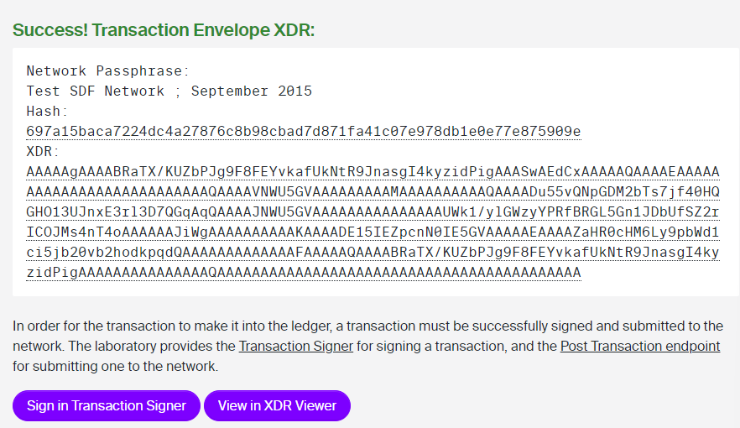
NFTs and the Metaverse
Create an NFT using the Stellar Laboratory
Finally, scroll down and click on ‘Sign in Transaction Submitter’.
Session 06: Laboratory

Slide 17
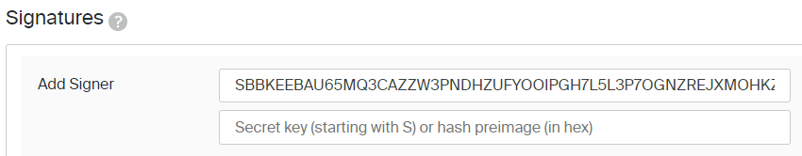
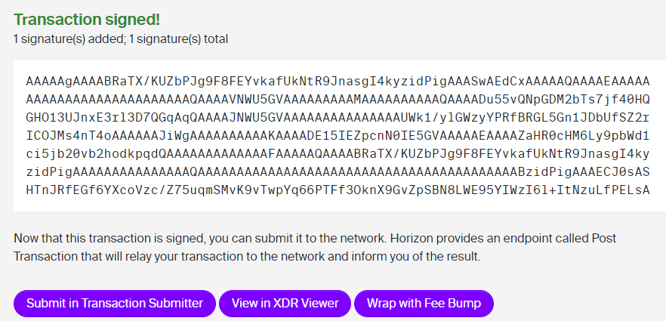
NFTs and the Metaverse
Create an NFT using the Stellar Laboratory
In the ‘Signatures’ form sign with the secret key of the Issuer.
Then, click on ‘Submit in Transaction Submitter’.
Session 06: Laboratory

Slide 18
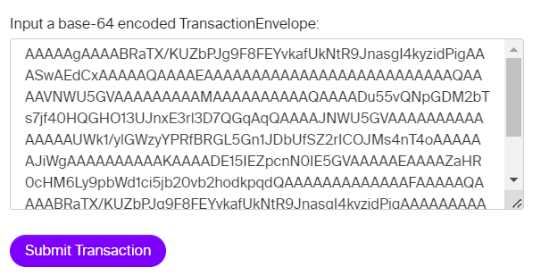
NFTs and the Metaverse
Create an NFT using the Stellar Laboratory
Finally, click on ‘Submit Transaction’.
Session 06: Laboratory

Slide 19
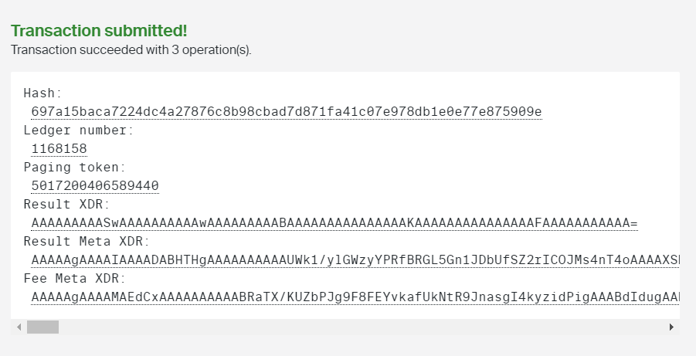
NFTs and the Metaverse
Create an NFT using the Stellar Laboratory
Congratulations! You have successfully created your very first Stellar NFT!
Session 06: Laboratory

Slide 20
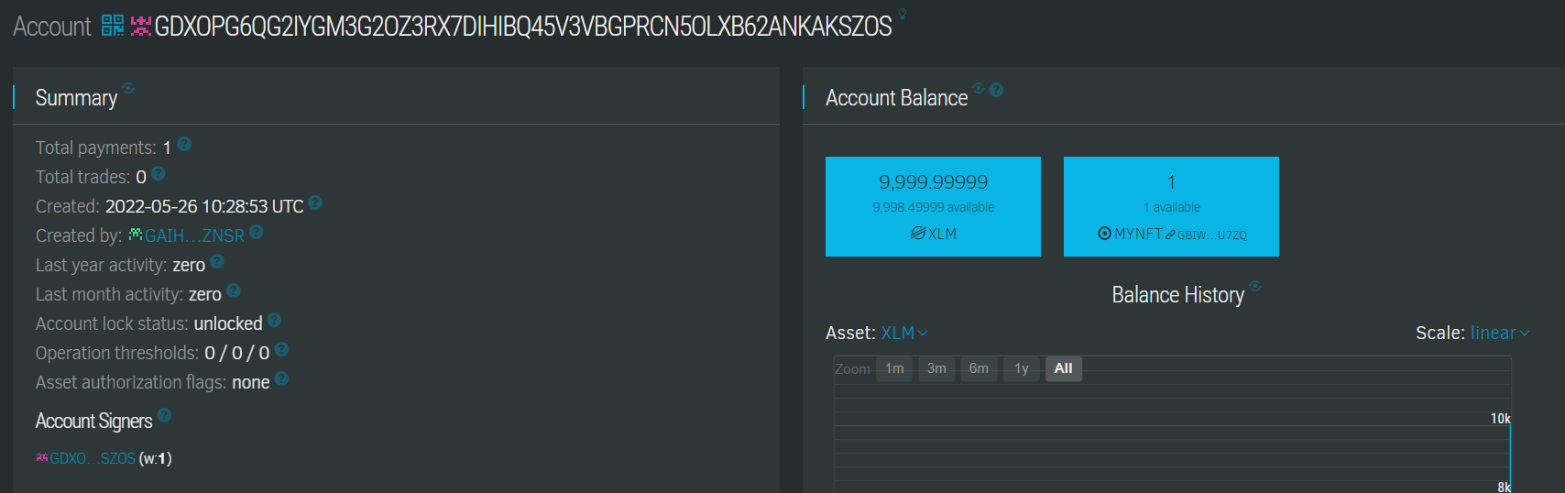
NFTs and the Metaverse
Create an NFT using the Stellar Laboratory
You can head over to Stellar.expert (always make sure you are working on the testnet) in order to check the transaction.
Indeed, in the Distributor account (copy and paste the public key of the Distributor account in the search bar), you can see that the NFT named ‘MYNFT’ has been successfully issued.
Session 06: Laboratory

Slide 21
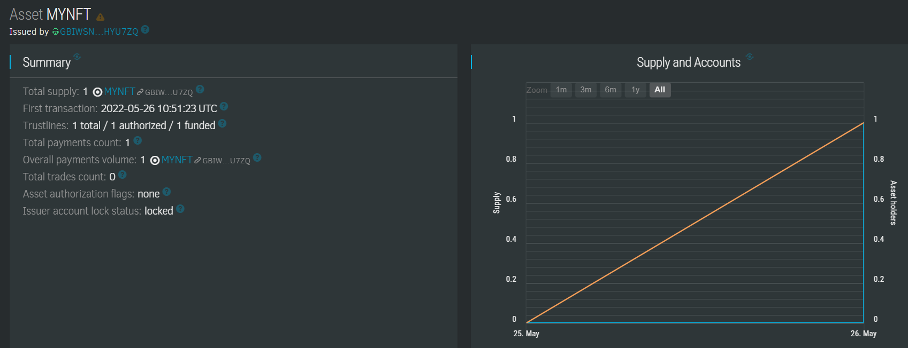
NFTs and the Metaverse
Create an NFT using the Stellar Laboratory
Moreover, if you click on the ‘MYNFT’ blue box, you will get further information about the NFT.
Specifically, you will see that it was issued by the Issuer with the public key ‘GBIWSNP7FFDFWPEYHU….’, that the status of the Issuer account is indeed locked and that the amount of the payment is indeed 1 XLM.
Session 06: Laboratory

Slide 22
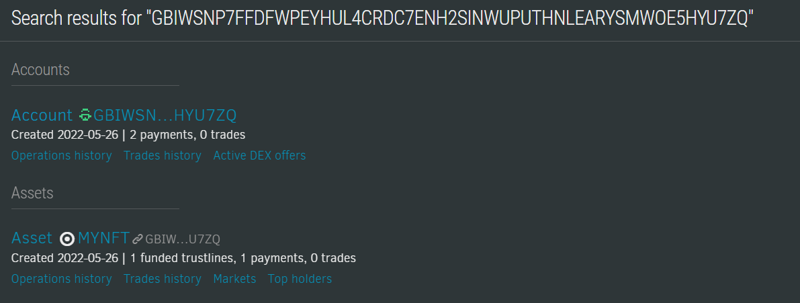
NFTs and the Metaverse
Create an NFT using the Stellar Laboratory
Accordingly, you can search with the public key of the Issuer.
In this case, you will get two different search results; one about the Issuer’s account and one about the Issuer’s NFT.
The Issuer’s NFT information will give you the same exact information as the dashboard we previously saw.
Session 06: Laboratory

Slide 23
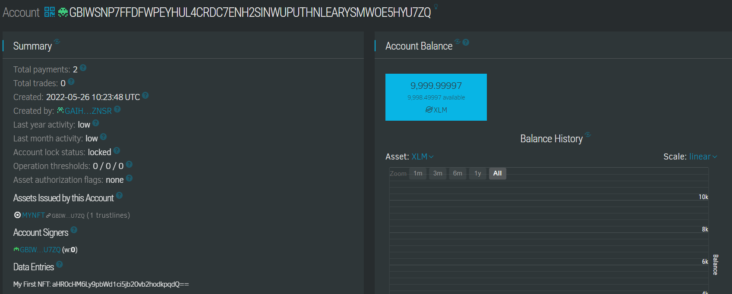
NFTs and the Metaverse
Create an NFT using the Stellar Laboratory
However, the Issuer’s account dashboard is going to give you information about the balance of the account, which is indeed reduced by 1 XLM due to the issuance of the NFT, the Data Entries with the name of the NFT, the total assets issued by the account etc.
Session 06: Laboratory

Slide 24
NFTs and the Metaverse
Create an NFT using the Stellar Laboratory
As always, in order to secure your NFT badge, make sure that you copy and paste the transaction ID into Moodle!
Session 06: Laboratory

Slide 25
Questions?
Contact Us: Stellar Developers Discord
Twitter: @StellarOrg

